Slide 1


Smart Disease Prediction System
This presentation introduces the Smart Disease Prediction System. It is an AI-powered web application. The system predicts diseases based on user-entered symptoms.
by K.S. Sreeviddya

Slide 2




Addressing the Core Problem
Early Detection
Accessibility
Healthcare needs timely and accurate disease detection.
There is often a lack of immediate access to doctors.
Reliability
A dependable tool is needed for symptom-based prediction.

Slide 3





Our Innovative Solution
Symptom Input
Disease Prediction
Comprehensive Guidance
Personalized Advice
Users input symptoms in plain text.
The system predicts potential diseases.
It also provides precautions and medications.
Offers diet and workout suggestions.

Slide 4

Key Software Requirements
Frontend
Backend
Built with Streamlit framework.
Powered by Python programming language.
Libraries
ML Model
Utilizes pandas, numpy, sklearn, and pickle.
Employs Support Vector Classifier (SVC).

Slide 5
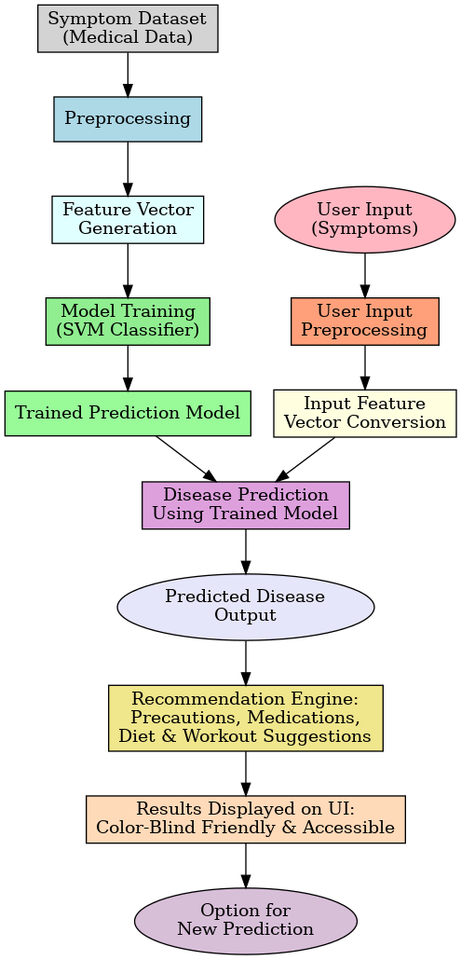




System Architecture Overview
User Input
Users enter their symptoms.
Preprocessing
Data is vectorized for processing.
Model Prediction
ML model predicts the disease.
Output Display
Recommendations are displayed.

Slide 6
Project Development Phases
Problem Research
1
Healthcare prediction needs were thoroughly studied.
2
Data Collection
Dataset of symptoms and diseases was gathered.
Model Training
3
Trained the SVC classifier, Random Forest, etc. model.s
4
Frontend Design
Built user-friendly Streamlit application UI.
Deployment
5
Deployed to the Streamlit Cloud.

Slide 7
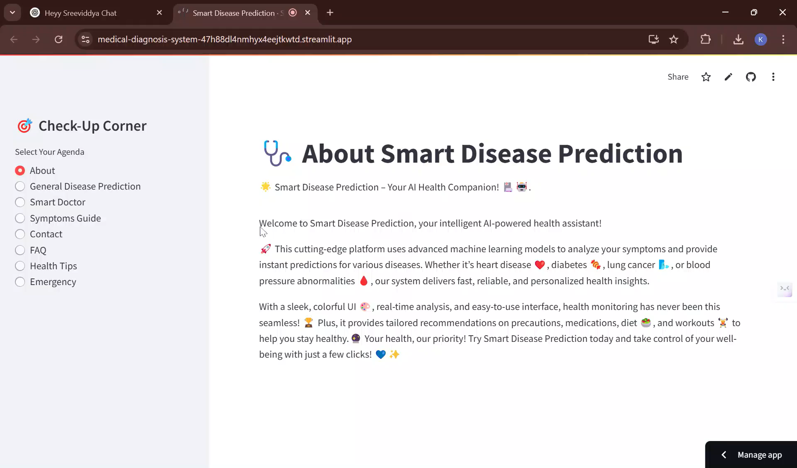
Website Demonstration
This brief video showcases the website's functionality and user interface. (https://medical-diagnosis-system-47h88dl4nmhyx4eejtkwtd.streamlit.app/)

Slide 8
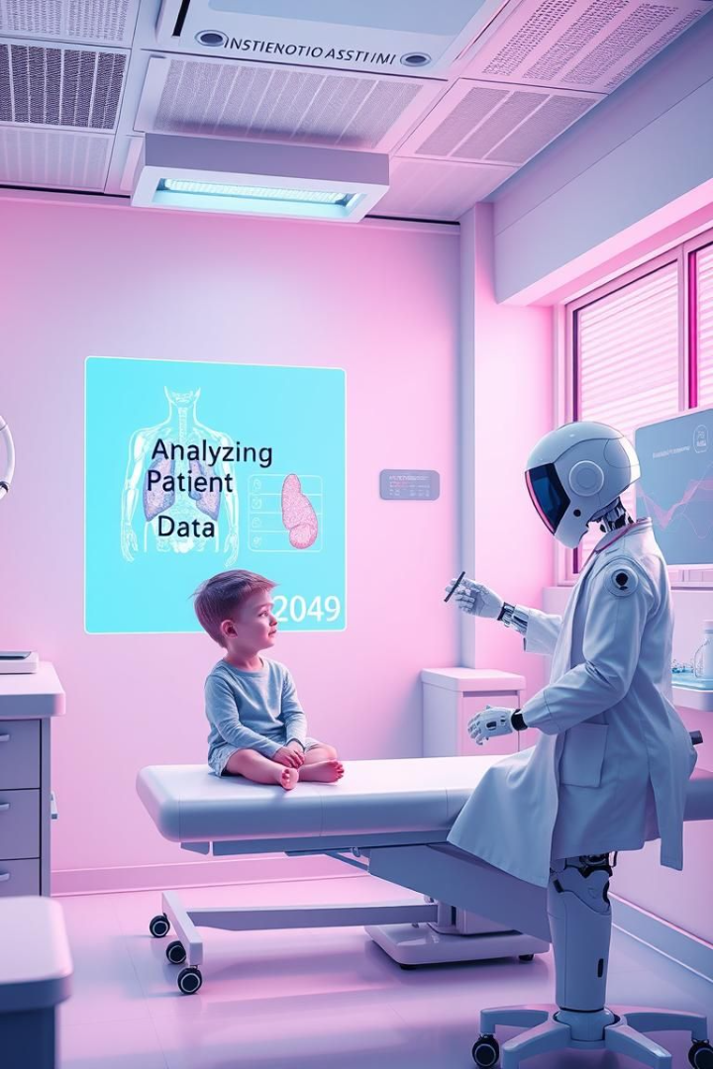
Future Enhancements
Voice Input
Enable voice-based symptom input.
Accuracy
Improve prediction accuracy.
Multi Language
Add multilingual support.

Slide 9

Conclusion and Acknowledgements
The Smart Disease Prediction System bridges the gap between symptoms and advice.
It is accessible, reliable, and scalable.
Thank you for your time!

